Slide 1
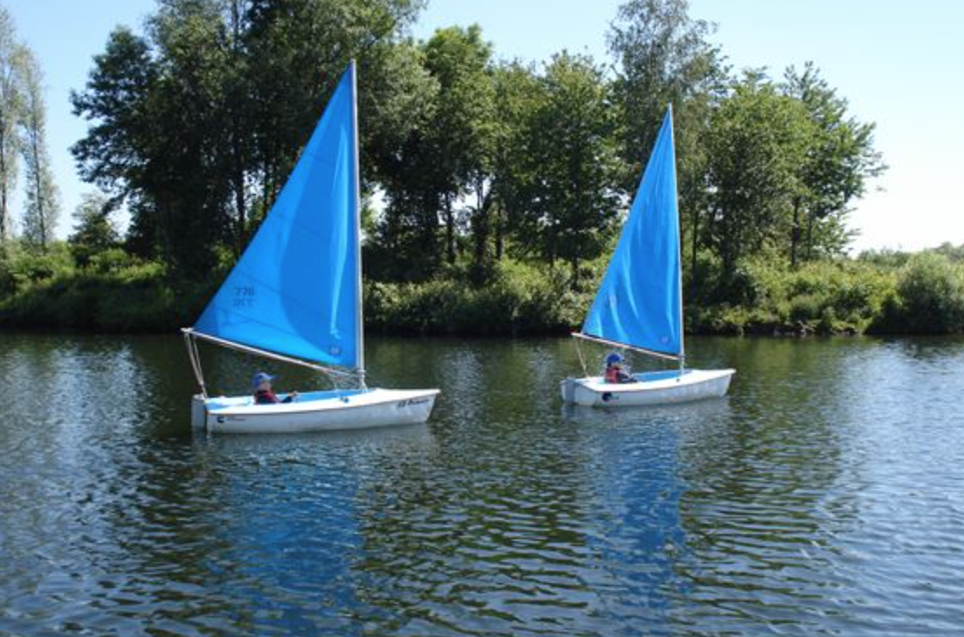
PRE-SEASON TRAINING

Slide 2
SESSION TIMES
Tuesday, Thursday
Full session times - 10am until 3pm
First Dinghy sailing session - 10am until 12pm
Second Dinghy sailing session - 1pm until 2pm
Times adjustable to suit individual Groups

Slide 3
CLUB LAYOUT
(not to scale)
Kitchen
(Galley)
Kit store
Sails
Masts
Booms
Dagger-boards
Rudders
Main Room
Entrance

Slide 4
TRAINING ROOM LAYOUT
(not to scale)
Ceiling mounted projector
Sailfree Locker
Dehumidifier
Training Cabinet
Door to be kept closed
Training Locker
Buoyancy aid and helmet racks
Ramp

Slide 5
LUNCH AT OSC
NO FOOD OR DRINK IS AVAILABLE TO PURCHASE AT THE MOMENT – PLEASE BRING YOUR OWN FOOD
Lots of fast food outlets available in Otley eg Fish & chips

Slide 6
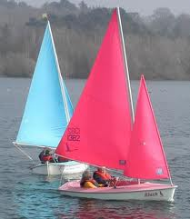
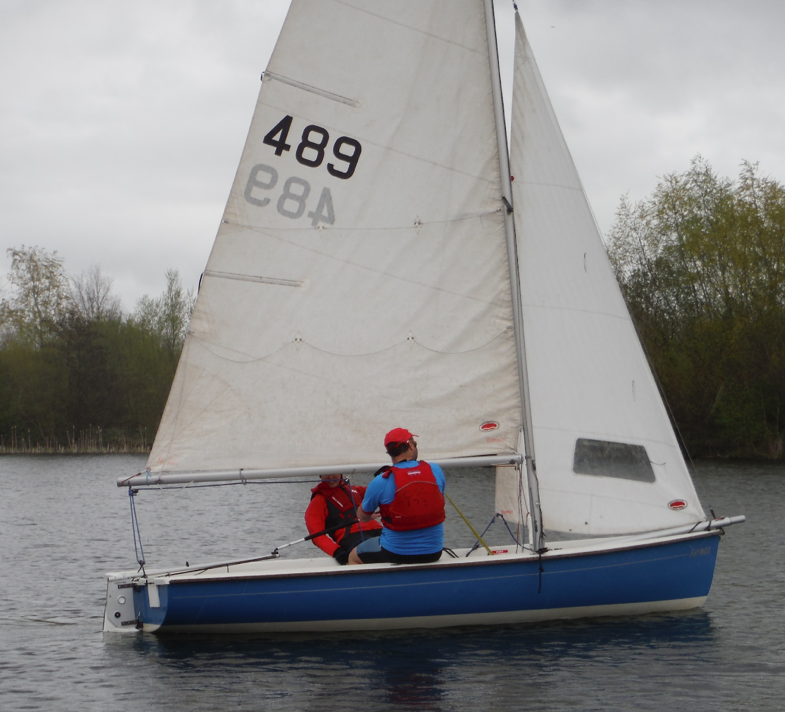
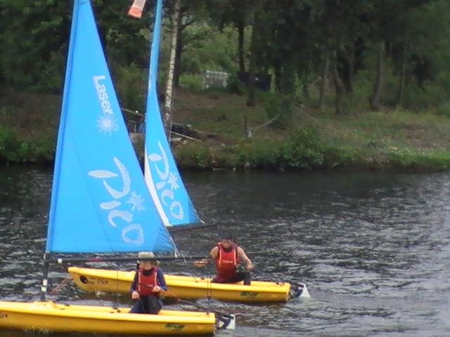
DINGHIES
ACCESS
COMET TRIO
PICO
BOATS USED WILL BE AT THE DISCRETION OF THE SAFETY TEAM / DAY LEADER

Slide 7
How to rig an access 303
Youtube clip – How to rig an access 303
9.21m
Link

Slide 8
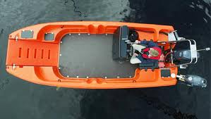
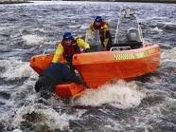
SAFETY BOAT
Type of Safety boat: Pioner Multi

Slide 10
PIONER FEATURES
2 longitudinal keels ensure the Pioner has superb sea keeping abilities and handling.
Highly buoyant.
Has a unique bow door system which can be lowered with a winch, and can be locked at any height for loading.
Door can be open while afloat at slow speeds only when approaching victim in water.
The door is wide enough to accommodate most wheel chairs.
THERE CAN CURRENTLY BE NO PASSENGERS IN THE SAFETY BOATS

Slide 11
SAFETY BOAT
Type of Safety boat: RIB

Slide 12
RIB FEATURES
Fast
Very Manoeuvrable
Aluminium hull is extremely strong
Cushioned “Sponsons” reduce risk of damage when coming alongside other boats
THERE CAN CURRENTLY BE NO PASSENGERS IN THE SAFETY BOATS

Slide 13
LIFE JACKET RULES
Life jackets or buoyancy aids MUST be worn at all times when on the water side and on the water including ALL water craft e.g. Safety boat / sailing boat / Canoe etc – NO EXCEPTIONS
Life jackets and buoyancy aids available – see the shore based team.

Slide 14
Hand held radios
Who should be equipped with a radio?
Day Leader / SI
Safety boats
DIs
Shore based support team
Beach master
Carer’s supporting high risk occupants
Not to be shared between ‘bubbles’
12 available
Radio checked prior to use
Must be set to channel 37
Do not carry by the antenna!

Slide 15
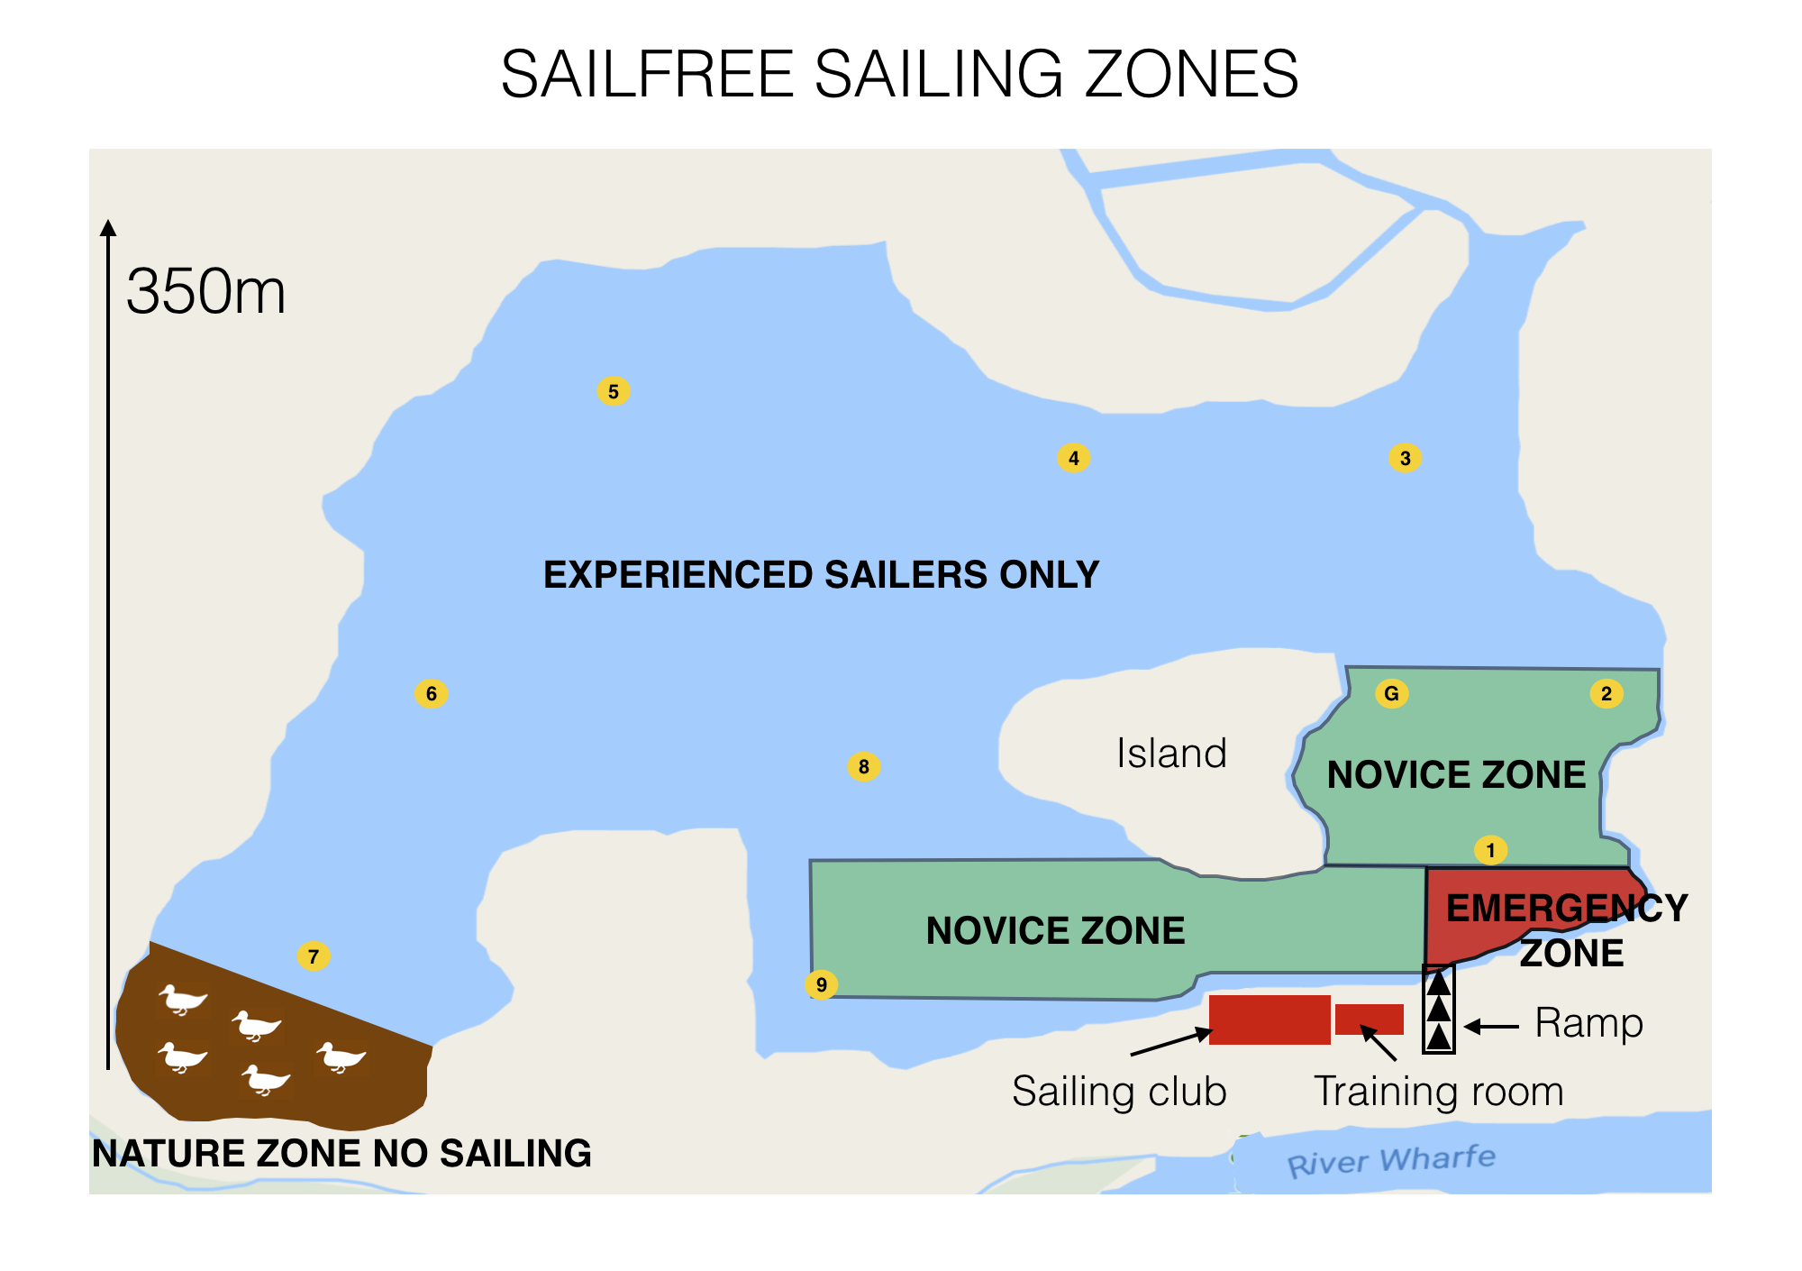

Slide 16
PROCEDURES FOR THE DAY
Upon arrival all visitors will meet on the patio
ALL visitors MUST SIGN IN
Task allocation by Day leader / SI
Prepare crafts / buoyancy equipment
Sail
Stow boats & equipment
Tidy up
Clean toilet
Depart

Slide 17
COVID-19 PRECAUTIONS
Wear a face mask when distancing is not possible (e.g helping people into and out of boats)
Hands must be gelled before touching any part of a boat
Limited numbers of people on the pontoon
Boats must be disinfected between users
Lateral flow test within 48 hours of the session must be negative (available free from pharmacies or NHS test and trace)
The toilet is not a changing room and you must clean it after you have used it
No passengers in the power boats
Buoyancy aids will be disinfected between uses
Items such as Radios must be cleaned between different users

Slide 18
OSC VOLUNTEERS: WHAT ARE YOU RESPONSIBLE FOR?
A RYA Senior instructor will be responsible for the overall running & safety of the session.
Volunteers with help from School staff will be responsible for the shore side support.
Only someone who has attended pre-season training can assist with preparation & sailing the dinghies.
ONLY volunteers with a minimum of PB2 and annual update can operate the safety boat.
If you have NOT received PRE-SEASON training you MUST be supervised by a volunteer who is trained.
Check the fit of buoyancy aids

Slide 19
SCHOOL STAFF:WHAT ARE YOU RESPONSIBLE FOR?
School staff are responsible for their pupils at all times
Suitable clothing for weather conditions / sun cream
Aware of risk assessments and behaviour management for all pupils and communicate these to the SI
Pupils personal belongings (e.g. securing glasses)
Personal Slings used for dinghy sailing
Medication
Lunch
Personal Care

Slide 20
SAILING RISK ASSESSMENTS AND SAFETY DOCUMENTS
AVAILABLE ON OSC WEBSITE
OSC Safety Manual 2021
OSC Sailability manual 2021
Risk assessments:
Dinghy
Sailfree
Safety boat
General
Covid

Slide 21
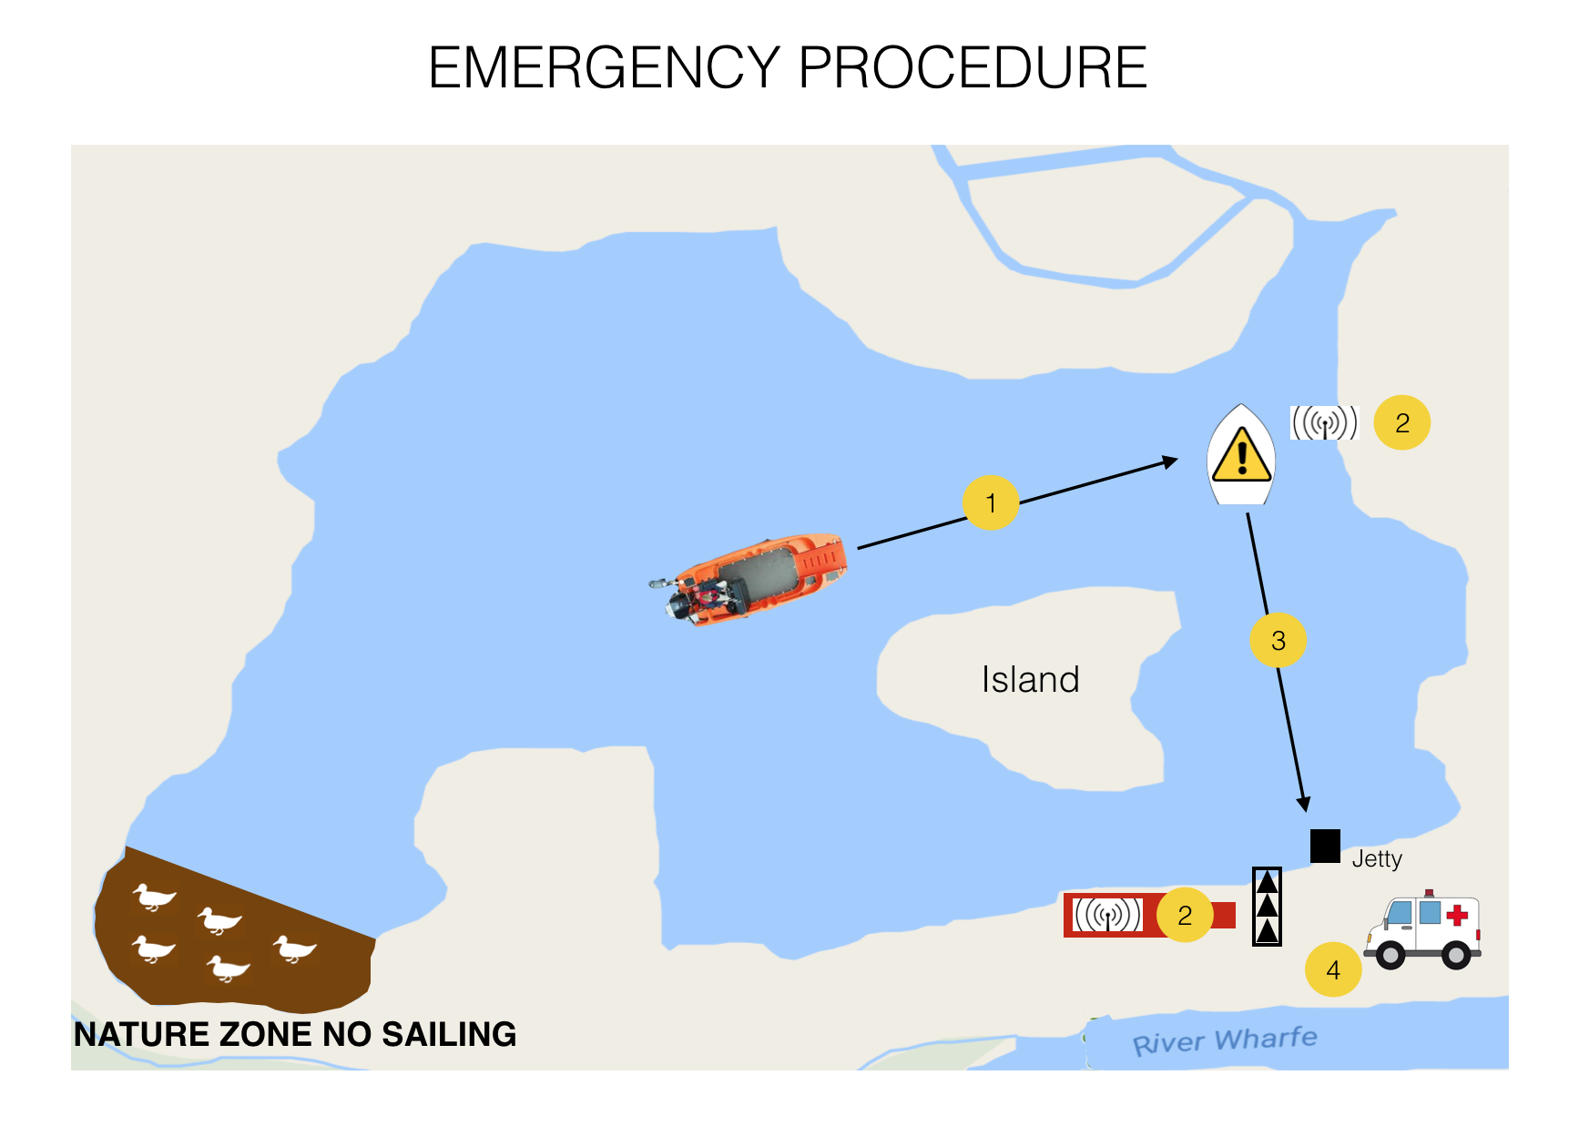

Slide 22
EMERGENCY PROCEDURE
Dinghy signals for assistance
Safety boat proceeds to the dinghy and begins to tow the dinghy in to the jetty
Shore base (1) goes to dial for emergency services in the club house and immediately organises someone to go down with a radio to unlock the gate and remain there until the ambulance arrives – leaves gate open for ambulance to exit. If you do need to call the emergency services there is a record of the grid reference etc of the club house on a notice on the bar area. It would be a good idea if everyone were aware where the notice is. If an air ambulance is required, our what3words location is: bring.playback.mining
Safety boat tows dinghy in to the concrete jetty

Slide 23
EMERGENCY PROCEDURE - cont
Safety boat driver moors safety boat and goes to help with the disembarkation of the service users and staff from the dinghy using hoist. An alternative in an emergency would be to lift the centre board and roll the dinghy onto one side in shallow water on the slipway.
Shore base (2) and safety boat driver disembark service user and staff member
Staff member takes service user to waiting ambulance
Safety boat driver informs gate that ambulance is on way out

Slide 25
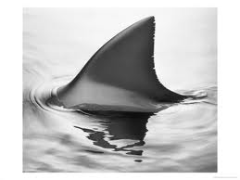
FINISH
Any Questions
Practice
On the water
Led by Otley Sailing club
Qualified
instructors
Enjoy !!

